Slide 1
Automatic identification of dialects in the western part of Germany
34th IAFPA Conference Trier - 24th June 2026
Vatho Chem & Reinhold Greisbach
IfL - Phonetik Köln
chemvatho@gmail.com
reinhold.greisbach@uni-koeln.de

Slide 2
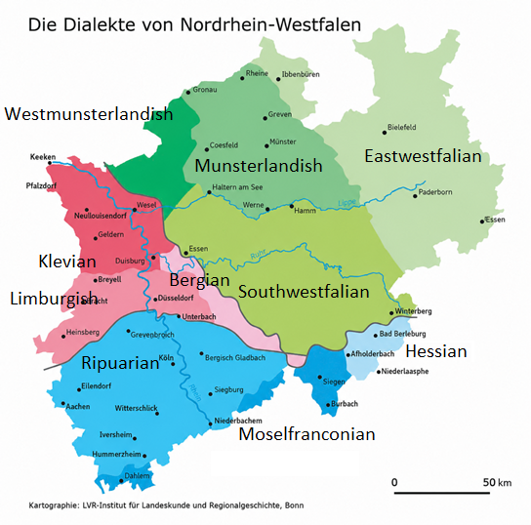
Dialects in Western Germany (North Rhine-Westphalia)
How are the dialects defined?
- isogloss bundles (mainly separating
consonant realisations!)
- naming based on historical territories or tribes
In the western part (North Rhine-Westphalia)
- green: Westphalian dialects (low German)
- red: Lower Franconian dialects (low German)
→ Rhenian fan (transition zone)
- ek / ech Uerdingen line
- make / mache Benrath line
- blue: Franconian dialects (central German)

Slide 3
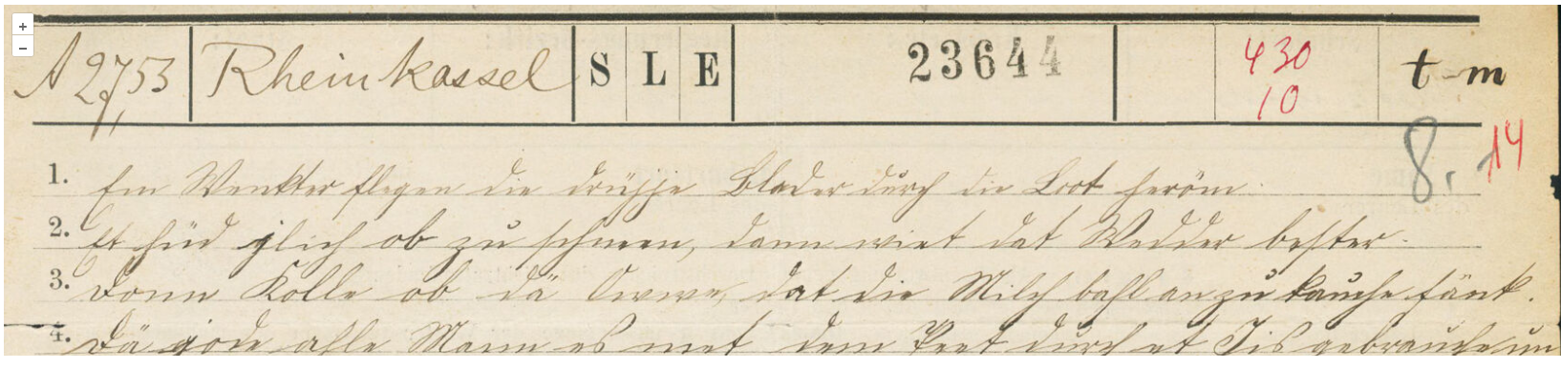
Database
How did we come to the exact location of these isoglosses?
The basic definition of dialect boundaries (in Germany) is based on the survey originally carried out by Georg Wenker between 1876 and 1887.
Wenker set up 40 sentences which should be translated into the local dialect by the teachers of all of the villages in Germany. The teachers should translate it and write it down in orthography.
Example from my school: Köln-Rheinkassel (https://apps.dsa.info/wenker/transliterations/23644/1/new)
1. Im Winter fliegen die trockenen Blätter durch die Luft herum.
1a. Em Wenkter flegen die drüjje Blader durch die Loot heröm.
1e. In winter fly the dry leaves through the air around.
2. Es hört gleich auf zu schneien, dann wird das Wetter wieder besser.
2a. Et hüd jlich ob zu schneen, dann wirt dat Wedder *** bester.
2e. It stops … to snow, then become the weather again better.

Slide 4
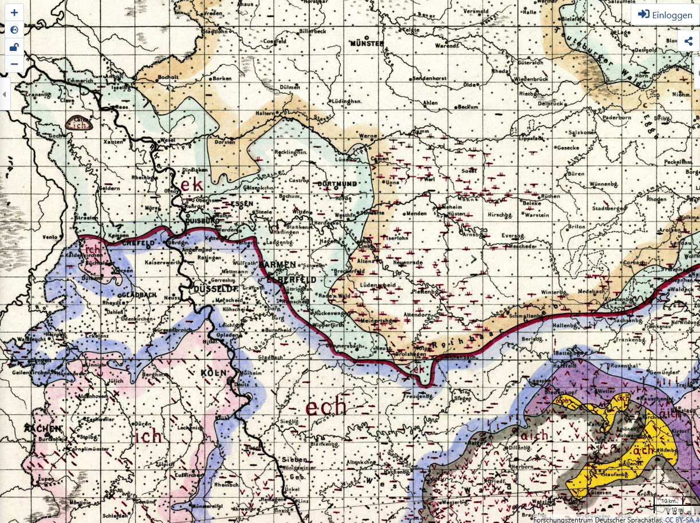
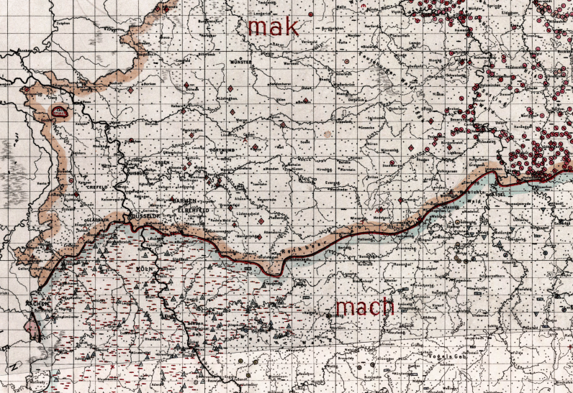
Example from Wenker‘s maps
Distribution of
  „I“ (ik/ich)
    → Uerdingen line
Distribution of
  „make“ (make/mache)
    → Benrath line
Collected 50.000 villages all over Germany, starting in the Rhineland 1876
Wenker‘s material is today archived in the „Deutsche Sprachatlas“ in Marburg.
originally drawn on maps of 1 m x 1 m
nowaday accessible via the internet
Wenker could determine the origin of the speaker from a short audio sample within some kilometers:
Is this still possible today?
Is this still possible only using only Wenker‘s sentence #1?

Slide 5
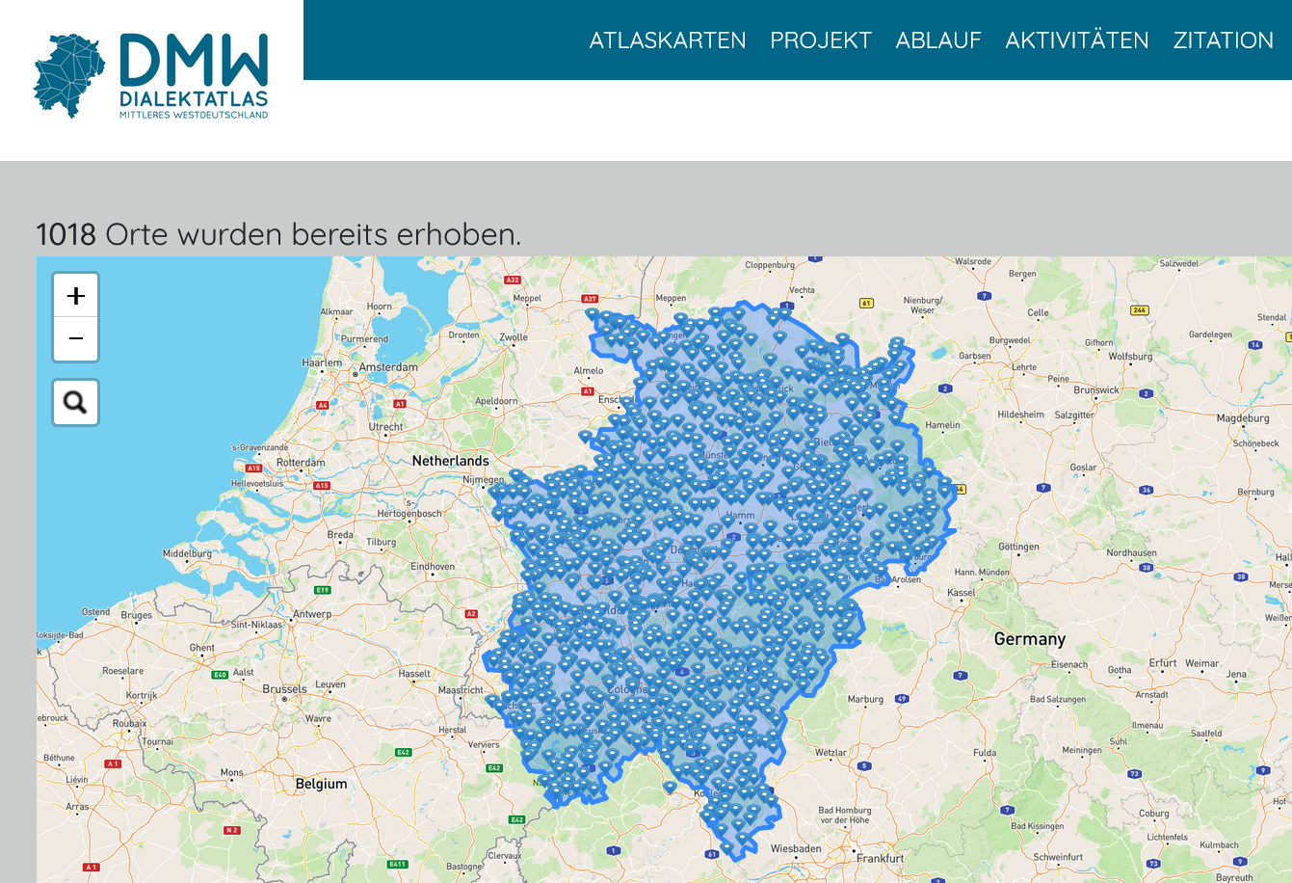
DMW (Dialectatlas central Westgermany)
DMW-Project: Project of Universities Münster, Paderborn, Siegen
PIs: Helmut Spiekermann, Doris Tophinke, Petra Vogel, …
Recordings of dialects in North Rhine-Westphalia++, Dialect speakers > 70 years, amongst other recordings: Wenker sentences, accessible via the internet, material not yet analyzed

Slide 6
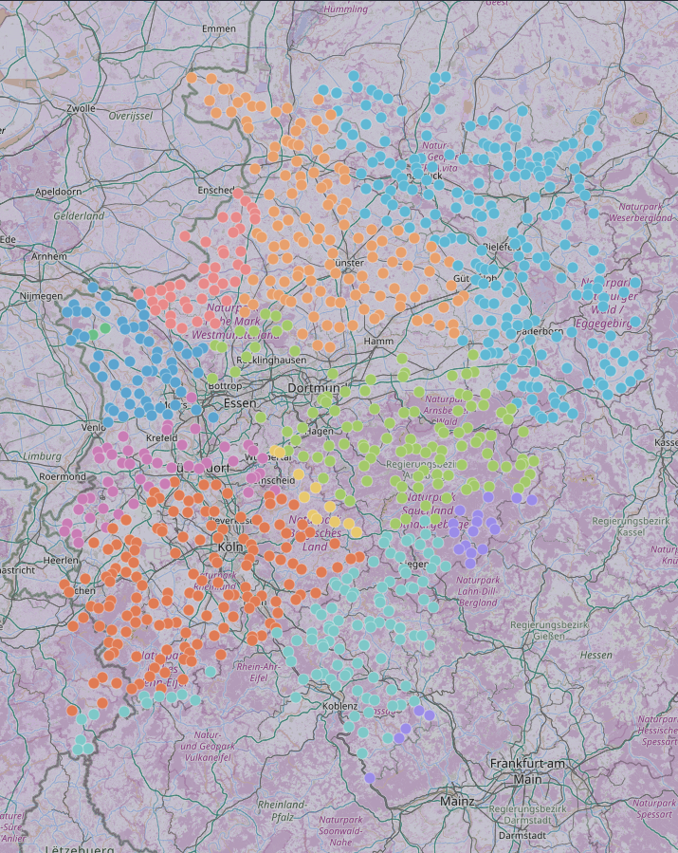
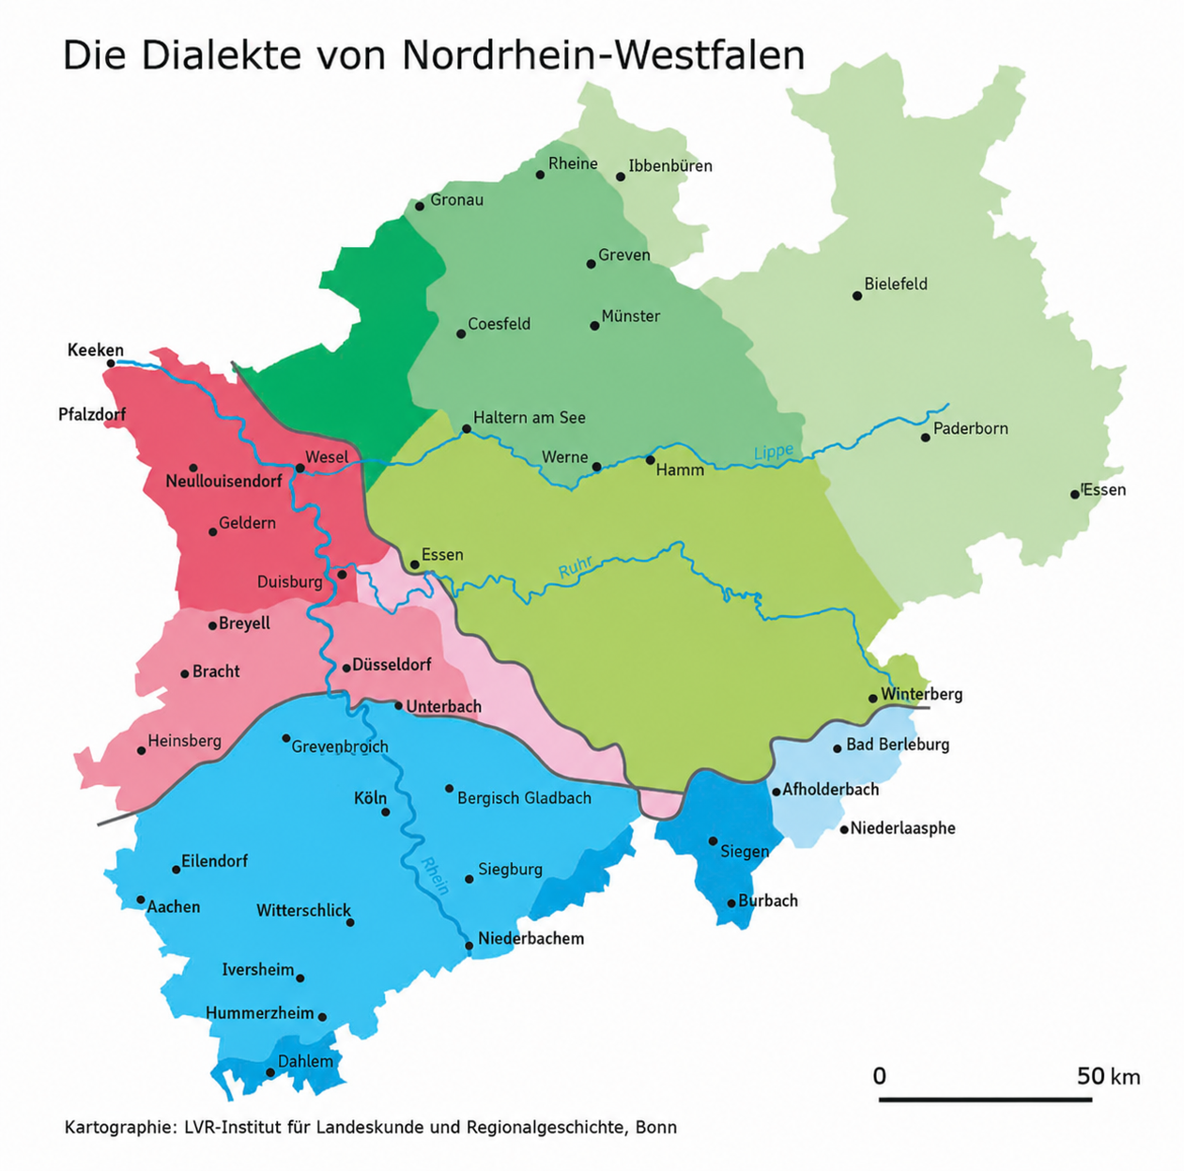
Dialect areas of the DMW corpus
DMW-area:
North Rhine-Westphalia + Osnabrück area + Westerwald
Total: 1018 villages (648 for Wenker sentence #1)
→ 1193 speakers for sentence #1

Slide 7
Automatic processing of audio signals
STEP 1a: Transcription of material AUDIO → IPA Symbols [automatic]
Orthographic transcription using the multilingual wav2vec2-XLS-R & jonatasgrosman/wav2vec2-large-xlsr-53-german
Audio → wav2vec2 encoder → CTC decoder → "Das ist ein Test.„
Phonetic conversion: phonemizer 3.3.0 & eSpeak NG 1.50
"Das ist ein Test." → eSpeak pronunciation rules → /das ɪst aɪn tɛst/
STEP 1b: Introduction of spaces (if necessary) [manual]
Village | Speaker
 |  | Im Winter fliegen die trockenen Blätter durch die Luft herum
Ruppichteroth | SI1143 | CTC im wonter flehende trübläder doto luftirren eSpeak ɪm vɔntɜ fleːəndə tɾyblɛːdɜ doːtoː lʊftɪrən eSpeak (plus spaces) ɪm vɔntɜ fleːən də tɾy blɛːdɜ doː toː lʊft ɪrə
Mehlem | BO1388 | CTC im winte flägen die toye bleiter in de luftrum eSpeak ɪm vɪntə flɛːɡən diː tɔøə blaɪtɜ ɪn deː lʊftɾʊm eSpeak (plus spaces) ɪm vɪntə flɛːɡən diː tɔøə blaɪtɜ ɪn deː lʊft ɾʊm
Zündorf | SI0911 | CTC im bünkte flüchet drühe lof in der loch arn eSpeak ɪm byŋktə flyçət dɾyːə loːf ɪn dɛɾ lɔx aɾn espeak (plus spaces) ɪm byŋktə flyç ət dɾyːə loːf ɪn dɛɾ lɔx aɾn

Slide 8
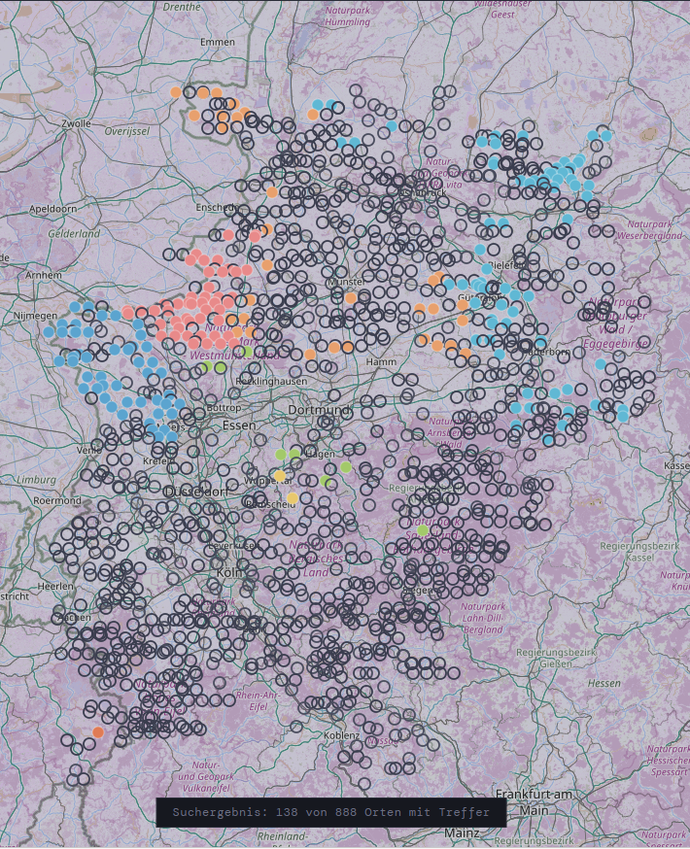
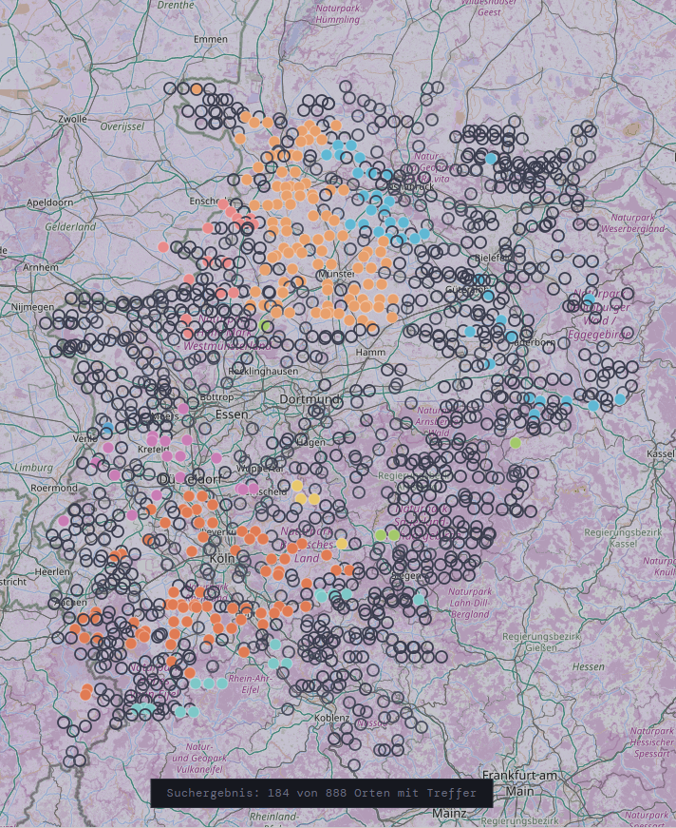
Local Distribution of automatically transcribed data
Im Winter fliegen die trockenen Blätter durch die Luft herum
Example searchstring: dɾø:* (dɾø:ge) dɾy:* (dry:je)
Regional clustering distribution of particular pronounciations → „Dialect marker“

Slide 9
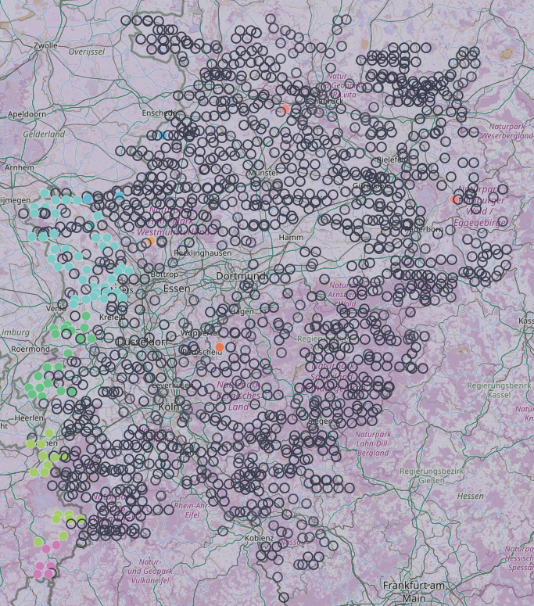
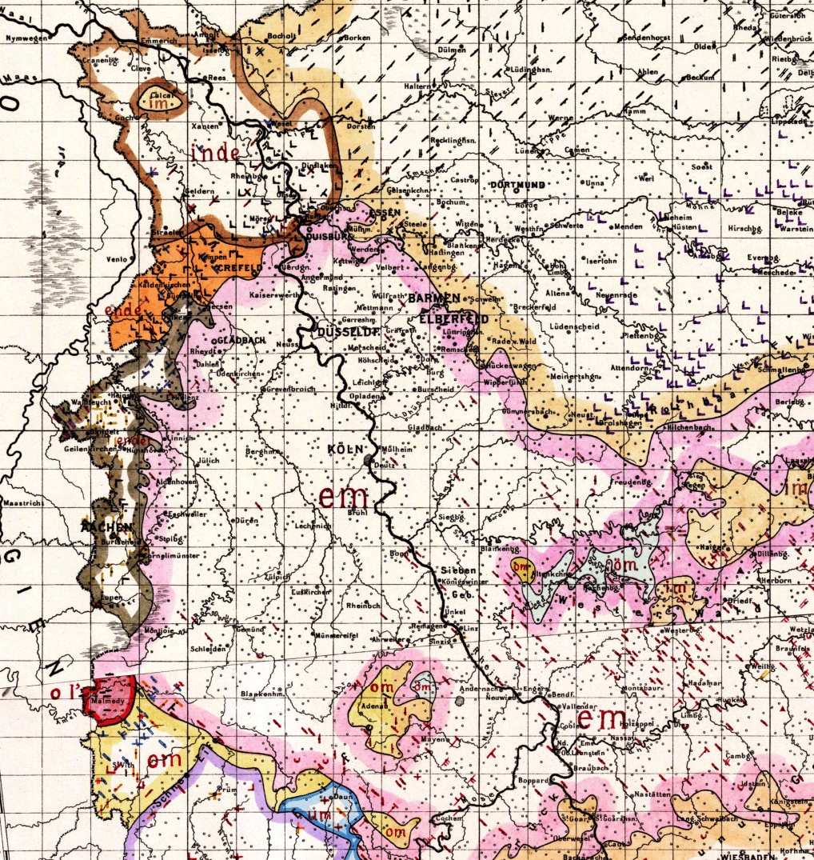
Dialect markers
STEP 2a: Identification of dialect markers, i.e. symbol sequences typical for specific regions
Example: Im Winter fliegen …
Searchstring: *_* (en_də / ɪn_də/ …)
The distributions may be not congruent with the traditional dialect boundaries!
                For every word there exists a specific geographical distribution!
Im Winter …
Wenker map for /im/
inde (Westmunsterland, Klevian)
ende (North Limburgian)
ender (South Limburgian, Ripuarian)
om (on de) (Moselfranconian)

Slide 10
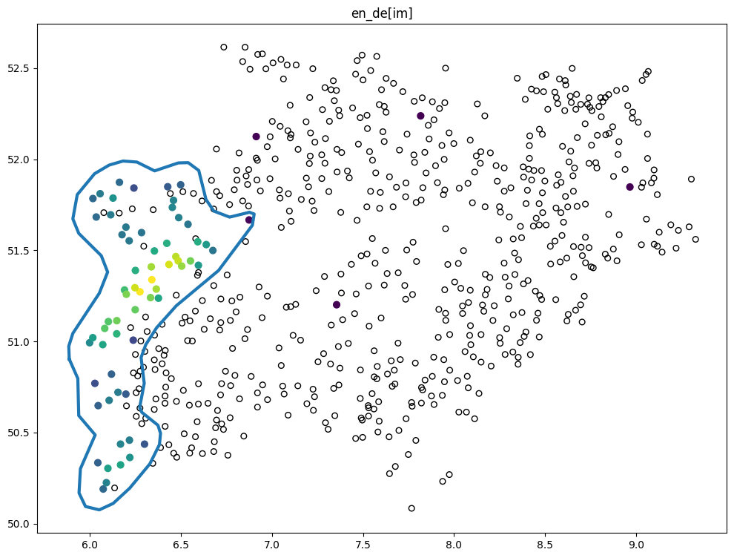
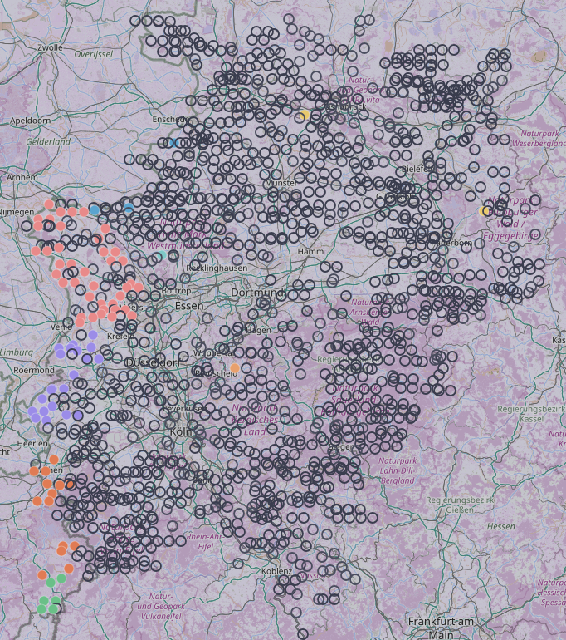
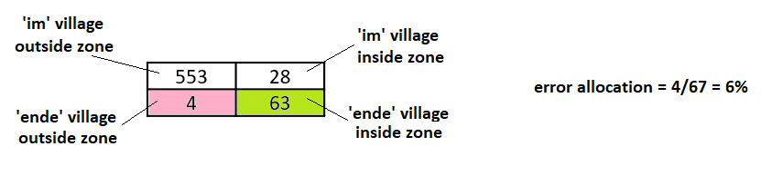
Generation of regional variants from the corpus
Real distribution of *_* (eg. en_de) Estimated zone of *_* (eg. en_de)
STEP 2b: Geostatistical procedure
  exclusion of irregular spread samples
  weighting of positive and negative samples
  smoothing of boundary
553 | 28
4 | 63

Slide 11
Basic pronounciation and regional deviation
Sentence #1 search strings for dialect markers (with error rates)
* and ? denote wildcards in the search string for the word
| and & denote logical operations in the search string for the word
! denotes negation in the search string for the word
Im in the | Winter winter | fliegen fly | die the | trockenen dry | Blätter leaves | durch through | die the | Luft air | herum around
ɪm | vɪntɐ | fli:ɡən | di: | tʁɔkənən | blɛtɐ | dʊʁç | di: | lʊft | hɛʁʊm
*_* (ɪn_də) 6 % | *ŋ* (vɪŋktɐ) 1 % | *t (flaɪɡət) 2 % | dɛ* 9 % | dɾy* & !*ɡ* (dɾy:jə) 20 % | bli* (bli:ɾ) 19 % | dy* (dy:ɾ) 6 % | --- | lu* | lo* 2 % | ɾ* (rum) 15 %
 | *nd* (vɛndɐ) 7 % | *a* (flaɪ…) 7 % |  | dɾy* & *ɡ* (dɾy:ɡə) 20 % | blɛ* 23 %
 |  | *ɔ*|*o*|*ø*|*œ* (floø...) 26 % |  | dɾø* & *ɡ* (dɾø:ɡə) 21 %
 |  | *ç* (flaɪçt) 25 %
 |  | *ʃ* (flaɪʃt) 16 %
 |  | *ə (fle:jə) 48 %

Slide 12
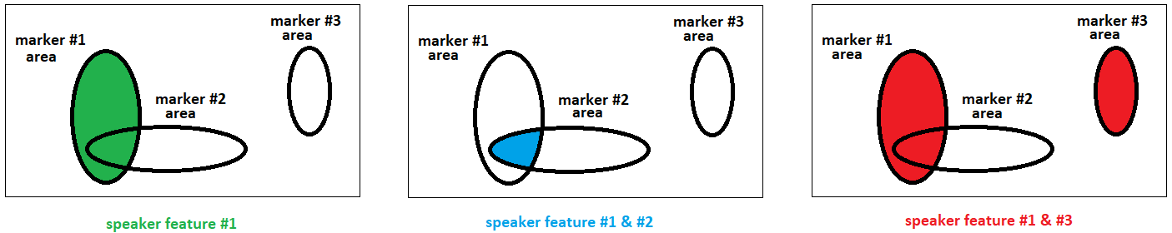
Selection of dialect markers
STEP 2c: Selection of dialect markers [manual]
Feature of dialect markers
  only positive (asymmetic) function:
    if found in utterance of speaker → locate the speaker in the respective region
    if not found in utterance of speaker → no effect !
Criteria for the selection
  every area has to have at least one dialect marker (manual extension at the outer boundaries if necessary)
  dialect marker should have a low percentage of wrong assignment
    village not from area → assigned to area
Effect
  choosing more markers will lead to a possibly more exact location of the speaker, but will introduce more errors.
→ every speaker has his own estimated area

Slide 13
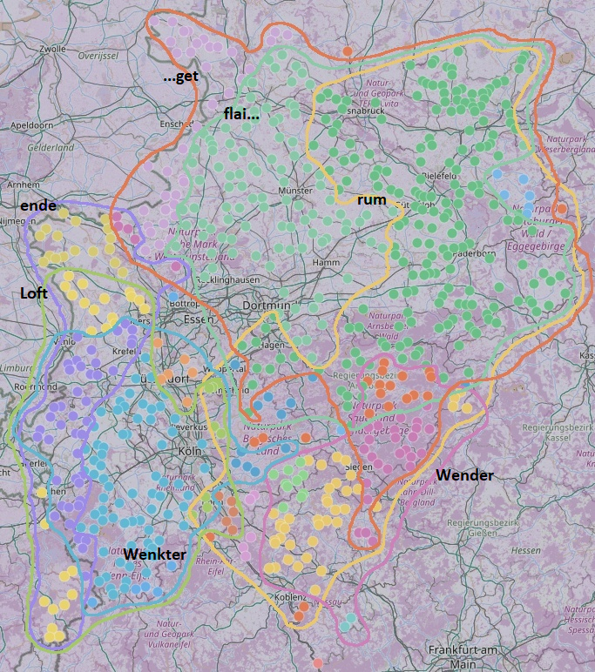
Local distribution of 7 markers of sentence #1
Distribution of estimated marker zones (zones estimated from data)
    Im Winter fliegen die trockenen Blätter durch die Luft herum
    1 im [ɛn də]
    2 Winter [vɪŋktɐ]
    3 Winter [vɪndɐ]
    4 fliegen [flaɪ...]
    5 fliegen [...ɡət]
    6 Luft [lo:ft]
    7 herum [rum]

Slide 14
Identificationrate
Checking for the chosen 7 markers
  → number of markers in the transcript of the speakers
    No marker (→ no allocation possible) 221 18.5 %
    At least one marker 972 81,5 %
Comparing every speaker with the markers of the 7 „marker zones“
  → allocation of speaker to a marker zone
    Correct assignment to marker zones in case of 1 marker 486 / 550 88.4 %
    Correct assignment to marker zones in case of 2 markers 308 / 357
      overlapping marker zones (→ more exact allocation) 308 / 352 87.5 %
      non overlapping marker zones 0 / 5
    Correct assignment to marker zones in case of 3 markers 44 / 63
      overlapping marker zones (→ more exact allocation) 40 / 45 88.9 %
      non overlapping marker zones 4 / 19
    Correct assignment to marker zones in case of 4 markers 0 / 2

Slide 15
Conclusion
A precise localization of a speaker is still possible, if
  there is precise information about the distribution of the pronounciation of the words used for classifying
This process could be done automatically
    even with the actual existing freely avaliable (but not optimized) speech recognition technologies
There may be problems due to individual disturbances
  bad acoustic conditions during recording
  imprecise articulation by the speaker (hesitations, …)
  imprecise translation by the speaker (different words, different phrasing, …)
Contradictions to the general assumption of dialectology
  free variations within the village dialect
  → ɪɕ han jezɛ:t ɔdɐ ɪɕ han jəzɛɪt dat əs eja:l ɛvɐ nɪt ɪɕ han jəza:t dat zɛ:t mɐ ɪn kœlə ɛvɐ nɪt he:
  I have said or I have said this is whatever, but not I have said this say you in Cologne but not here

Slide 16
Thank you!
This is all, wat ich üch hück jesaat han

Slide 18
Additional material
Ways to a more precise local identification:
Wenker sentence #2
Using our own new speech recognition system for the Cologne dialect
    → Chem, V. & Greisbach, R. (to come): KI-Based Automatic Transcription of the Ripuarian Dialect of German. Talk to be presented at the 11th Congress of the International Society for Dialectology and Geolinguistics, Marburg, September 2026.
Wav2Vec2 XLS-R-300M + Phonemic CTC head
    → Using self-designed speech recognition technique, trained especially with the Ripuarian dialect (105 speakers from Cologne, ca. 4 h transcribed audio signal)

Slide 19
Results of the Automatic Process for Wenker‘s sentence #2
Manually corrected missing words / divergent translation (of speakers)
    Es hört gleich auf zu schneien, dann wird das Wetter wieder besser.

Slide 20
Basic pronounciation and regional deviation
Sentence #2 in Ripuarian dialect area
traditional claim: „The Ripuarian dialect area is relatively homogenous.“
some words do not show any variation
  es, auf, zu, das, besser
for the other words we assume a standard pronounciation
  hy:t, ɡlɪç, ʃn*ə, dan, ve*|vɪ*, v*d*, v*d*
and localizable variants
  hø:t, hœʁt, ɡlɪəχ, ʃn*n, da, ?y*|vø*|vʏ*, j*, v*ʁ*, v*ʁ*
* and ? denote wildcards in the search string for the word
and deviations, which can be located
Es It | hört stops | gleich soon | auf --- | zu to | schneien snow | dann then | wird becomes | das the | Wetter weather | wieder again | besser better
ət | hy:t | ɡlɪç | ɔp | tsʊ | ʃn*ə | dan | ve*|vɪ* | ət | v*d* | v*d* | bɛsɐ
 | hø:t | ɡlɪəχ |  |  | ʃn*n | da | ?y*|vø*|vʏ* | dat | v*ʁ* | v*ʁ*
 | hœʁt |  |  |  |  |  | j*

Slide 21
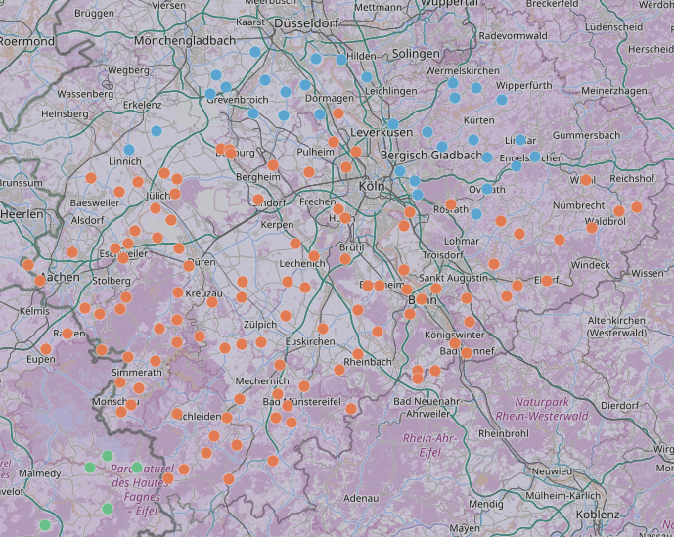
Way to a more precise local identification
Theoretical Distribution of variants of „wird“: [vi:t], [vy:t]/[vö:t], [gett]
    Standard Ripuarian [vi:t]
    Northern Range [vy:t]/[vö:t]
    High Venn [gett]
Distribution can be found in the maps of Wenker as well !

Slide 22
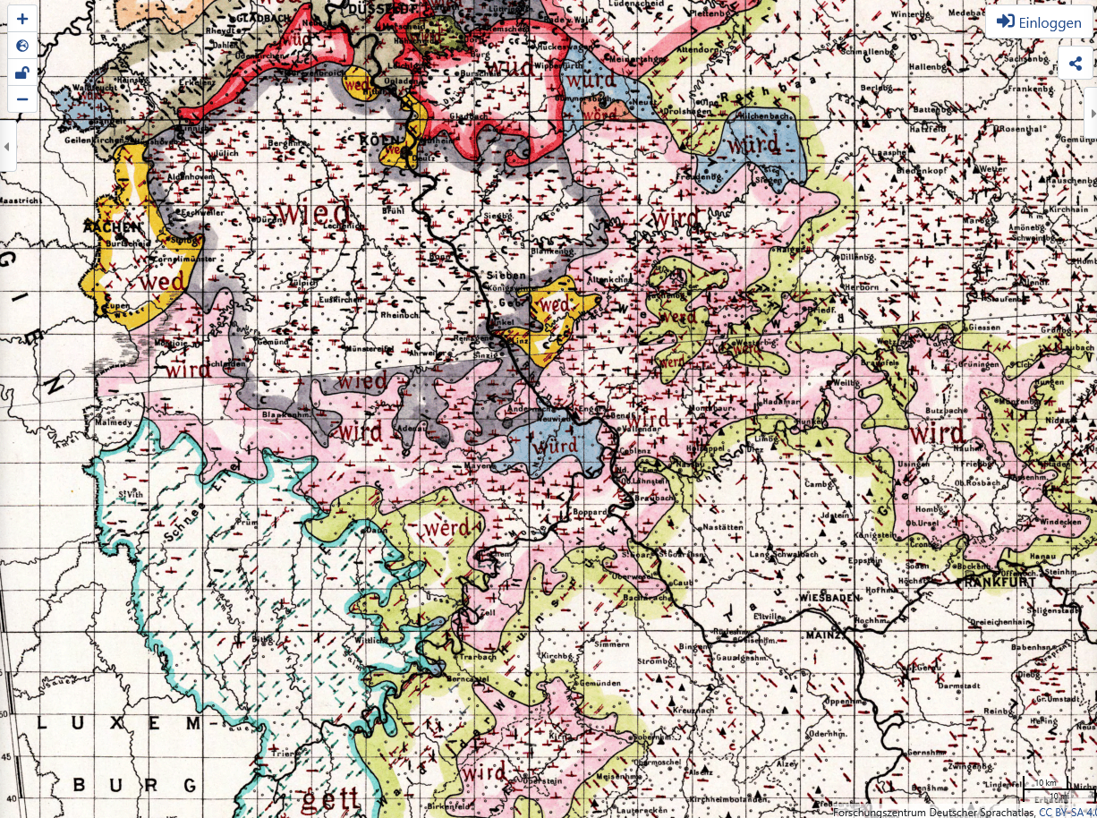
Way to a more precise local identification
For every word there exists a different geographical distribution!

Slide 23
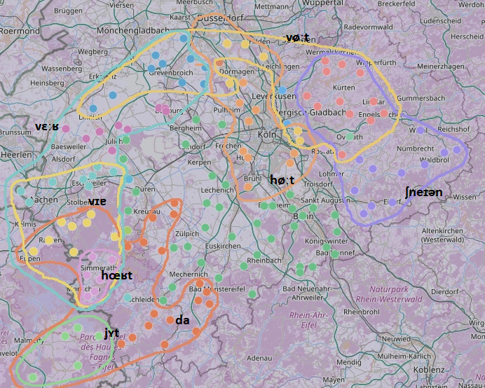
Distribution of the local distributions of the 6 words of sentence #2
Local deviations of standard Ripuarian (zones estimated from data)
    Standard: ət hyːt ɡlɪç ɔp tsə ʃneɪə dan veːt dat vɛdɐ vɪdɐ bɛsɐ
    1 hört [hœʁt]
    2 hört [høːt]
    3 schneien [ʃnəɪən]
    4 dann [da]
    5 wird [jɛt]
    6 wird [vøːt]
    7 Wetter [vɛːʁ]
    8 wieder [vɪɐ]

Slide 24
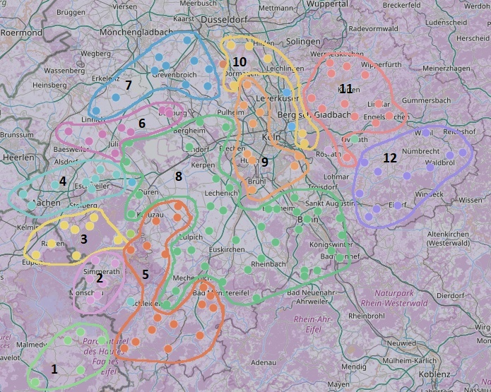
Overlaying the distributions of the 6 words of sentence #2
Sentence based subdivision of the Ripuarian dialect region [„subarea“]
    1 Hohes Venn
    2 Monschau
    3 Eupen
    4 Aachen
    5 Nordeifel
    6 Jülich
    7 Grevenbroich
    8 Center
    9 Cologne
    10 Rheinschiene
    11 Niederberg
    12 Oberberg

Slide 25
Identificationrate
Comparing every speaker with the marker patterns of the subareas
    Correct assignment of subarea 111 44.6 %
    No assignment 66 26.5 %
    Wrong assignment 72 28.9 %
Comparing every speaker with the markers of the marker zones
    Markers of speaker are subset of pattern of subarea
    Correct assignment of marker zones 188 75.5 %

